Slide 1
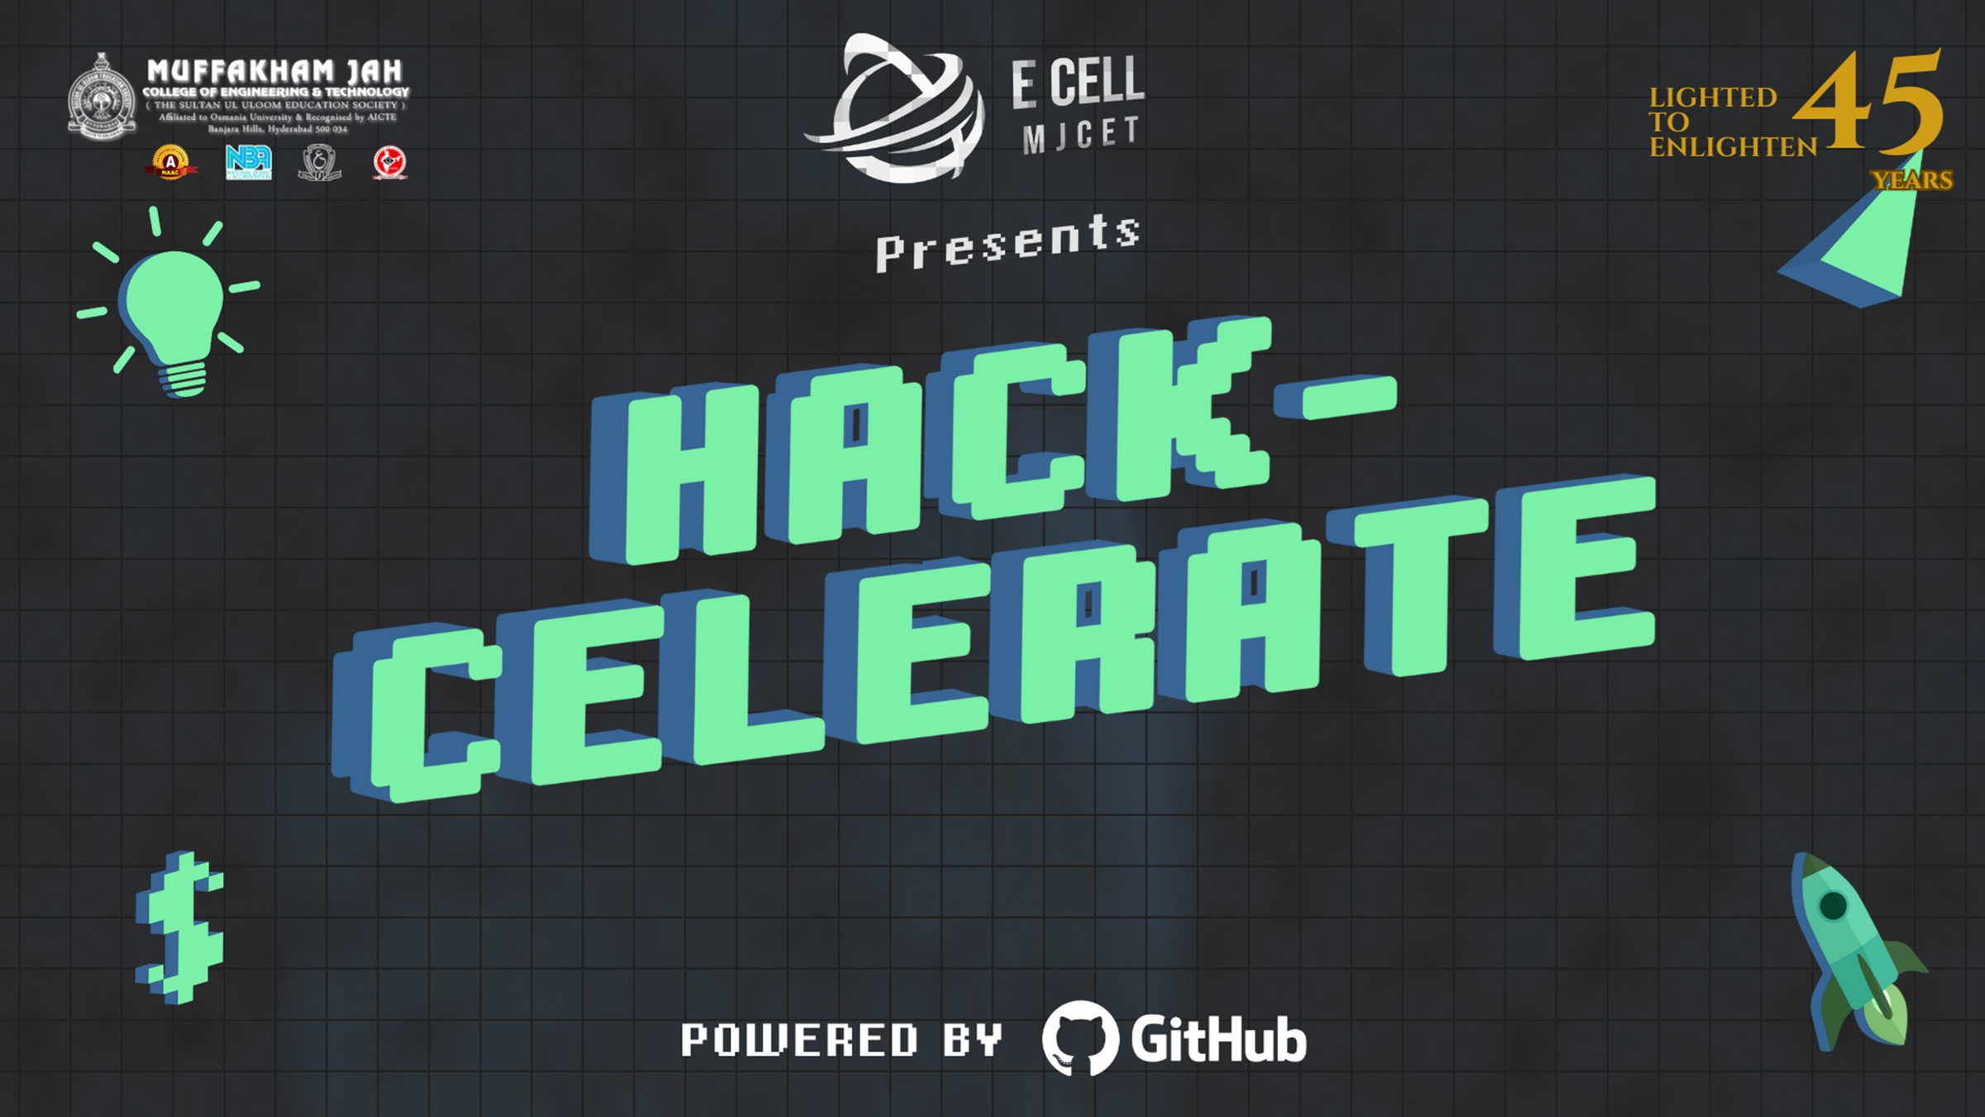

Slide 2

Shield Vision:
AI-Powered Real-Time Women's Safety System
Presented by Metarizz Squad from Prof. Ram Meghe College of Engineering and Management

Slide 3
Team Members
Name | Dept | Year
Mohammad Zeeshan Khan | CSE-DS | 2nd Year
Syed Sayam Ibrahim | CSE | 2nd Year
Sareem Adnan Khan | IT | 3rd Year
Shadan Anwar | AI&DS | 3rd Year
Talha Adnan | CSE-DS | 2nd Year
Prem Dinesh Wankhede | CSE | 2nd Year

Slide 4


PROBLEM
STATEMENT
Problem: Every day, countless women face harassment and violence without timely intervention. Current safety systems, like panic buttons or manual reporting, are reactive and fail to address real-time threats.
Challenges:
Delayed response times in emergencies.
Lack of automated threat detection.
Emotional and physical toll on victims.
Statistics:
Over 35% of women globally experience violence (UN Women).
80% of harassment cases go unreported due to lack of immediate help.

Slide 5

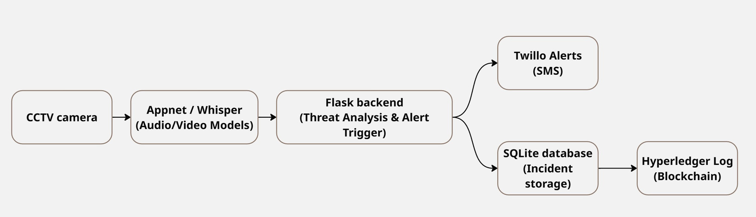
PROPOSED SOLUTION –
‘SHIELD VISION’
“Safe, Seen, Supported – Shield Vision Watches Over You”
01
02
03
Real-time threat detection using AI vision and audio.
Instant alerts to emergency contacts or authorities.
Privacy-first design with encrypted data processing.

Slide 6

OVERVIEW
INNOVATION
UI-FRIENDLY DASHBOARD: INTUITIVE INTERFACE FOR USERS TO MANAGE CAMERA FEEDS, ALERTS, AND SETTINGS.
LIVE FEED VIOLENCE DETECTION: APPNET-POWERED COMPUTER VISION DETECTS HARASSMENT OR ASSAULT IN CCTV FOOTAGE.
VOICE-BASED CRIME DETECTION: WHISPER AI IDENTIFIES DISTRESS SCREAMS OR SUSPICIOUS AUDIO IN PUBLIC SPACES.
EMERGENCY MESSAGING: TWILIO/TEXTBELT API SENDS INSTANT SMS ALERTS TO EMERGENCY CONTACTS OR AUTHORITIES.
CHATBOT SUPPORT: LANGCHAIN AND LLMS PROVIDE CONTEXT-AWARE ASSISTANCE AND GUIDANCE DURING CRISES.
SMART LOGIN & BLOCKCHAIN LOGS: SECURE USER AUTHENTICATION AND TAMPER-PROOF INCIDENT LOGGING USING HYPERLEDGER.

Slide 7
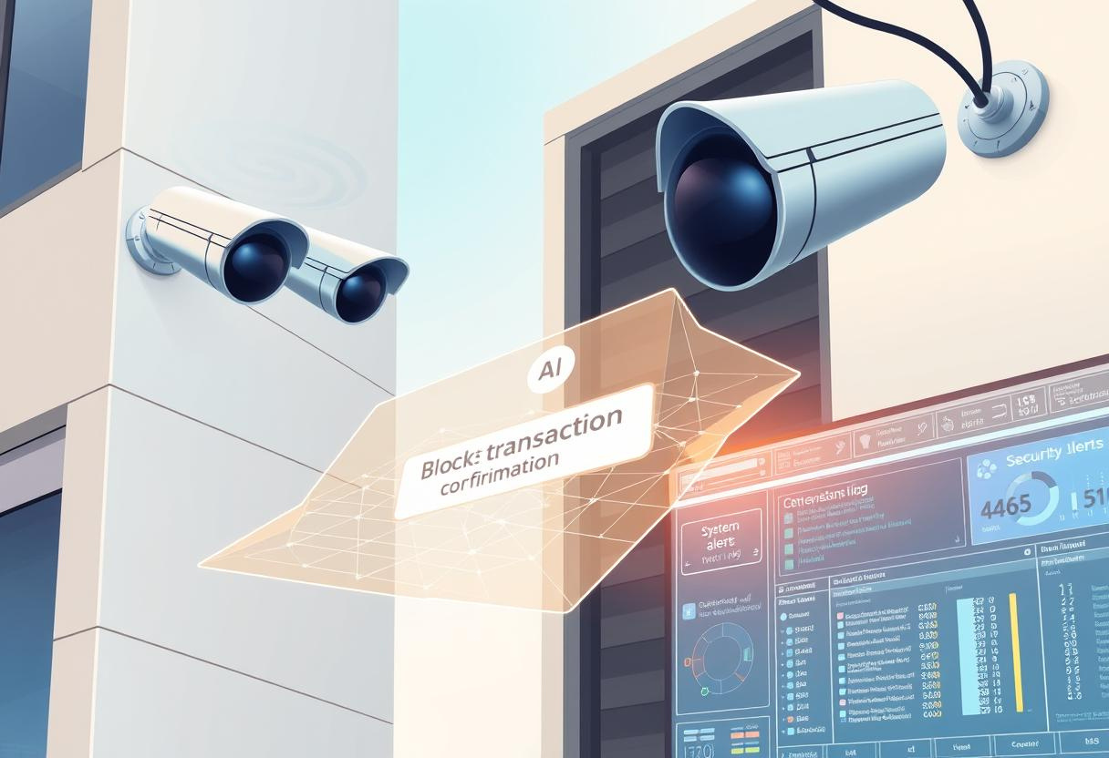
FEASIBILITY
Proven Technologies: Uses MobileNet, LSTM, Whisper AI, Flask, and SQLite — readily implementable.
Modular Architecture: Clear component separation for easier development and deployment.
Secure Design: Blockchain (Hyperledger) ensures tamper-proof incident logging.
Real-Time Utility: Instant alerts via Twilio/Textbelt APIs increase immediate impact.
Privacy-Focused: Encrypted, on-device processing preserves user privacy.
Low Hardware Barrier: Compatible with existing smartphones, CCTV, and wearables.

Slide 8

SCALABILITY
Edge + Backend Balance: Low-latency processing with centralized coordination allows regional expansion.
Versatile Business Models: Supports B2C, B2B, B2G, and OEM — scalable across sectors.
Wide Use-Case Applicability: Deployable in campuses, transit, cities, and personal safety.
Future-Ready Roadmap: Plans for smart wearables, multilingual AI, and global partnerships.
Continuous Learning: AI improves over time with real-world data inputs.
Market Alignment: Fits into the growing $5B women’s safety tech market (5.6% CAGR).

Slide 9
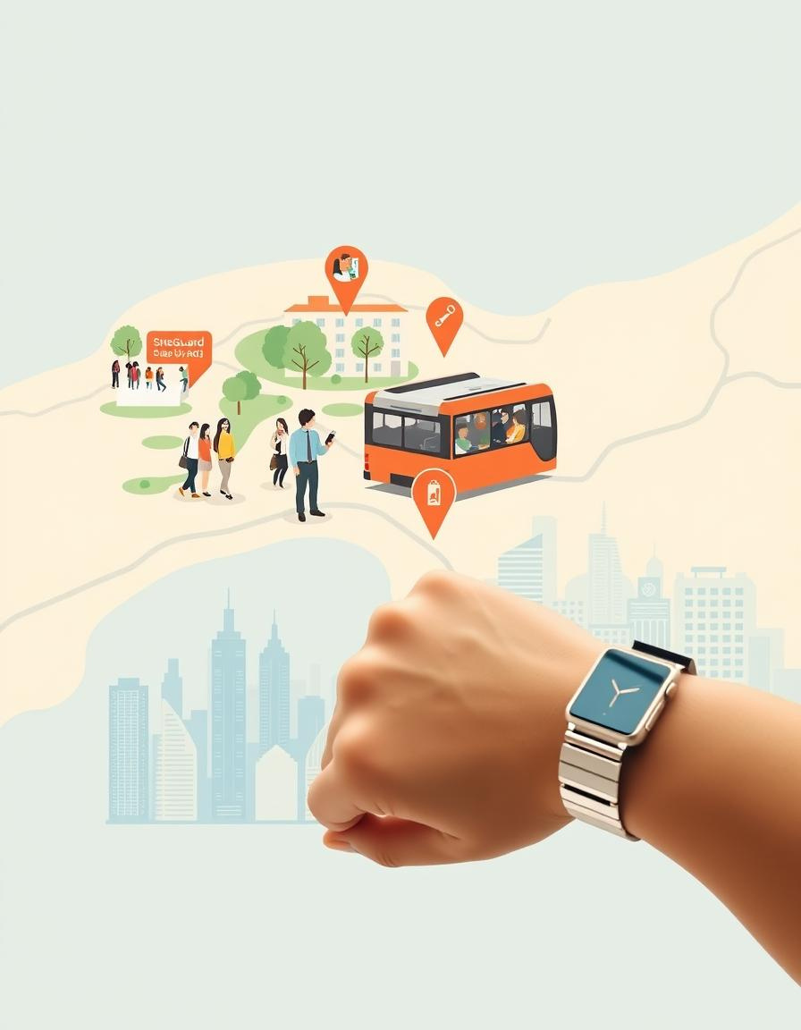
USE CASES
Campus & Hostel Safety: AI cameras in dorms and classrooms detect suspicious behavior and alert security.
Public Transit Surveillance: Shield Vision monitors buses, subways, and ride-shares for passenger safety.
Smart City Monitoring: Integrates with urban CCTV to flag harassment in public spaces like parks and malls.
Wearable Travel Companion: App or pendant for women traveling alone, with SOS and live tracking.

Slide 10
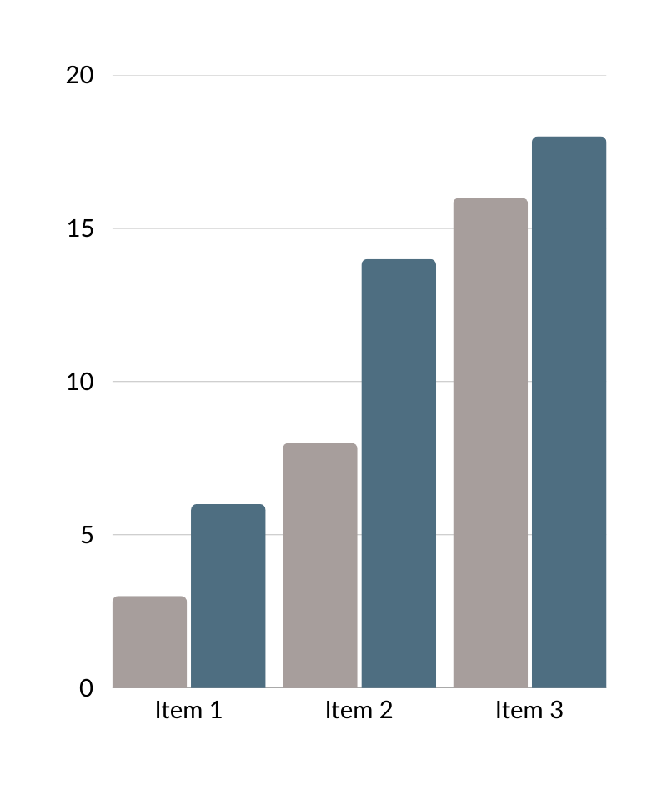
MARKET OPPORTUNITY
Market Size: Women’s safety tech market projected to grow at 5.6% CAGR through 2032 (~$5B by 2032).
Demand Drivers:
Rising urbanization and smart city initiatives.
Increased focus on campus and workplace safety.
Growing awareness of women’s safety issues.
Target Sectors: Smart cities, education, public transport, corporate offices.

Slide 11

BUSINESS MODEL
B2G (Business-to-Government): Contracts with municipalities for city-wide SheGuard surveillance networks.
B2B (Business-to-Business): Annual subscriptions for universities, corporations, and transit authorities.
OEM Licensing: Integrate Shield Vision AI into security cameras and IoT devices for manufacturers.

Slide 12
ROADMAP & FUTURE SCOPE
SHORT-TERM (6-12 MONTHS)
MID-TERM
(1-2 YEARS)
LONG-TERM
(3-5 YEARS)
Add gesture and fall detection to enhance threat sensing.
Launch beta mobile app with SOS and tracking features.
Develop smart jewelry (bracelets, pendants) with panic triggers.
Implement Hyperledger for tamper-proof incident logs.
expand to global markets with multilingual AI models.
Partner with international safety organizations for broader impact.
Continuous learning for AI models using real-world data.

Slide 13
IMPACT & VISION
Impact:
Faster Response: Real-time alerts reduce harm and improve outcomes.
Crime Deterrence: Smart surveillance discourages offenders.
Empowerment: Women gain confidence and freedom of movement.
Data-Driven Policing: Anonymized data identifies crime hotspots.
Vision: Support UN SDG #5 (Gender Equality) by leveraging AI to prevent violence and foster inclusive safety.
"Shield Vision isn’t just technology—it’s a movement to ensure every woman feels safe and empowered.”
– Metarizz Squad

Slide 14
THANK YOU

